Slide 1
Cascading Style Sheets
CSS
Prepared By: Hardi Patel

Slide 2
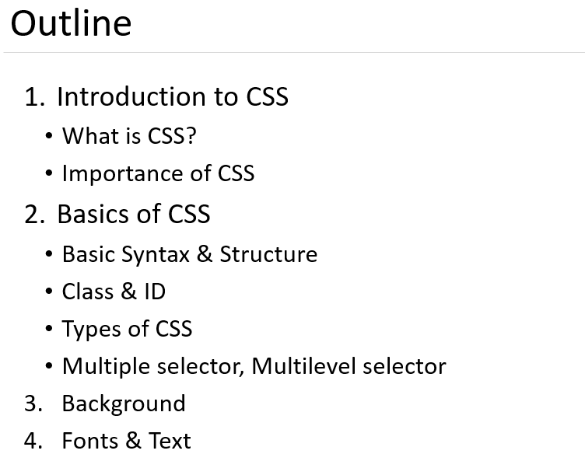

Slide 3
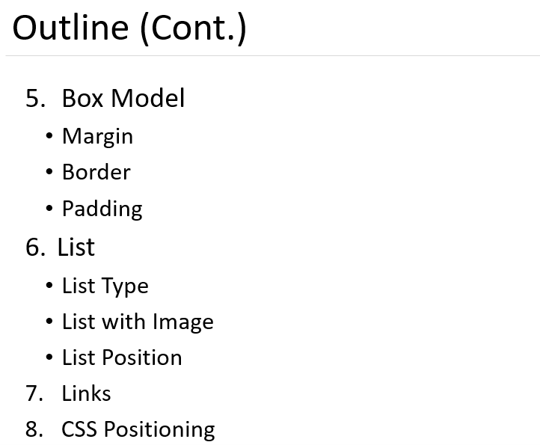

Slide 4
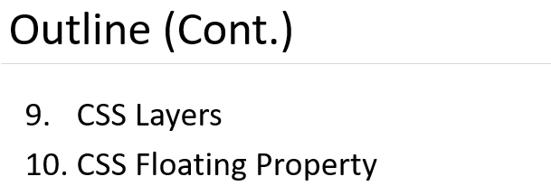

Slide 5
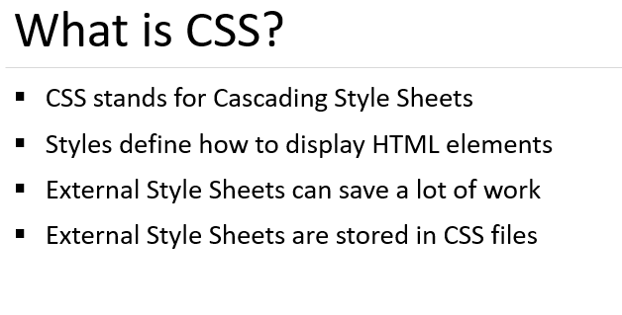

Slide 6
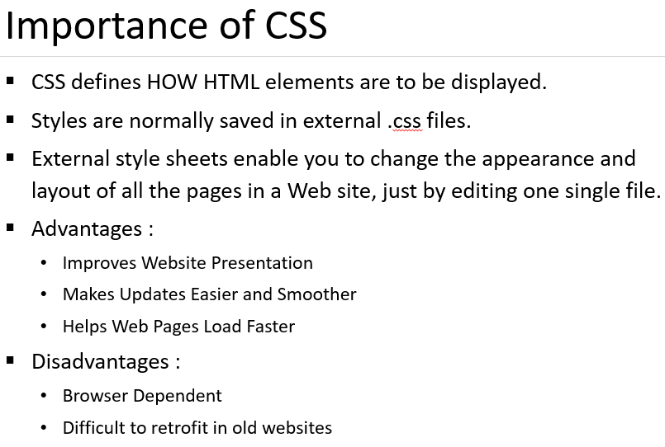

Slide 7
Applications
Save the time
Page load faster
Easy maintenance
Multiple device compatibility

Slide 8
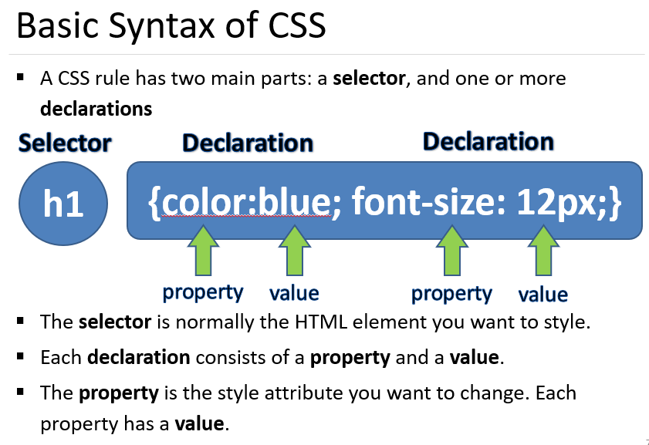

Slide 9
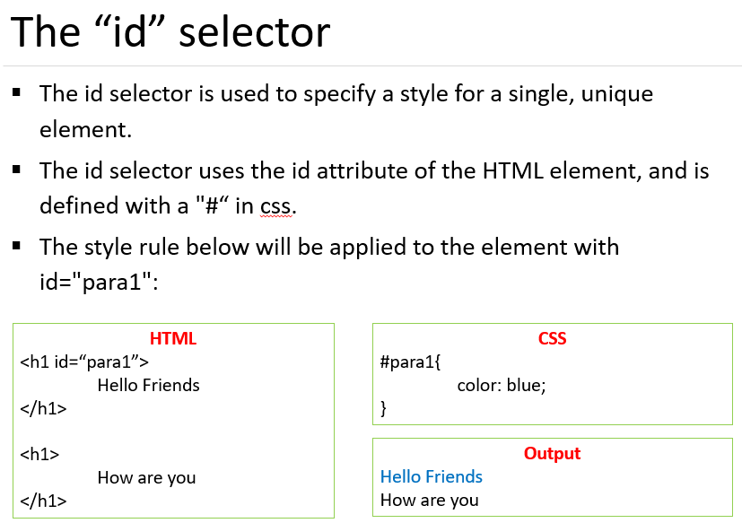

Slide 10
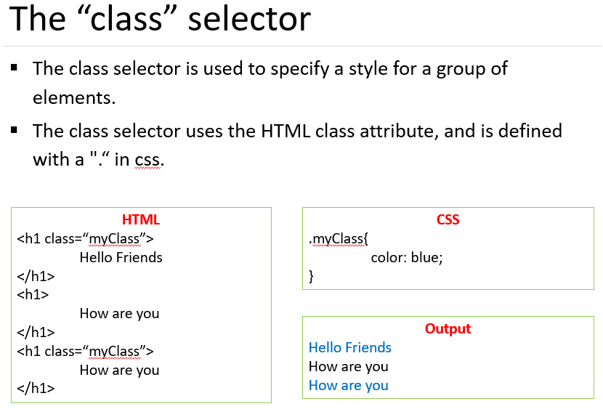

Slide 11
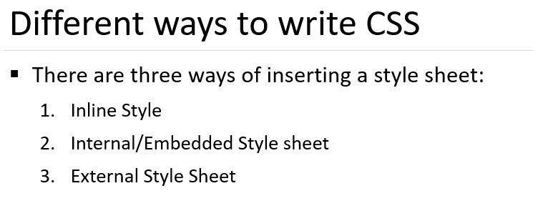

Slide 12
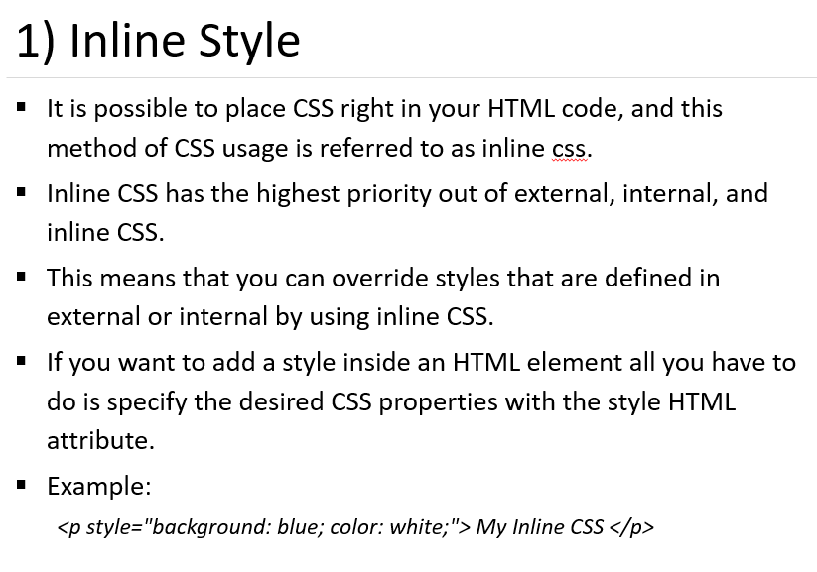

Slide 13
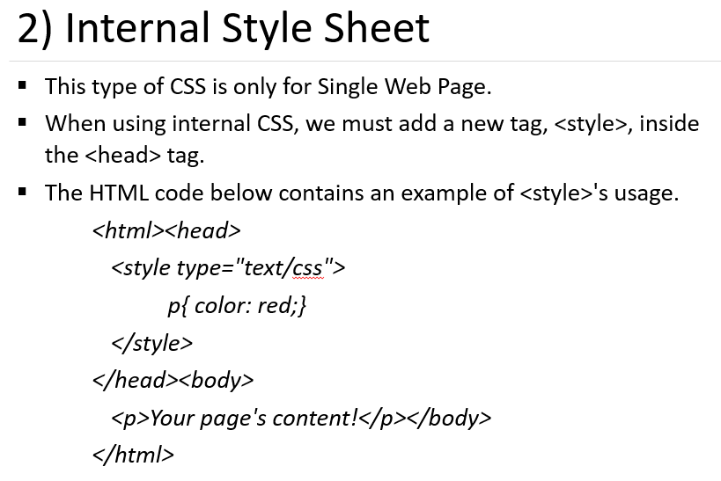

Slide 14
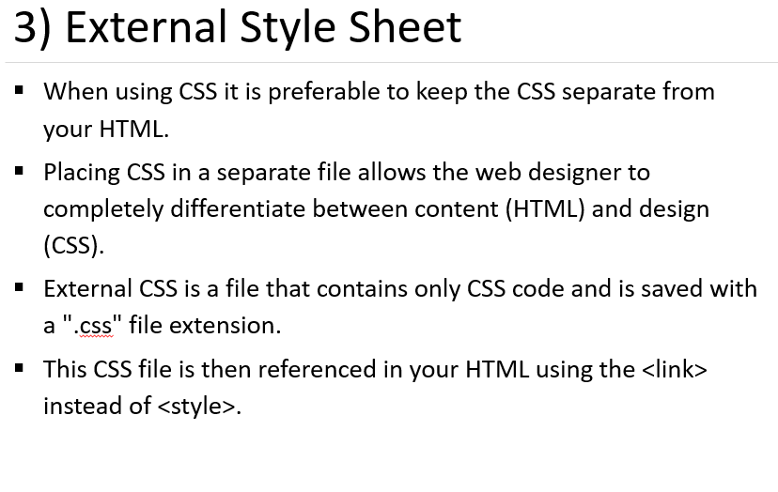

Slide 15
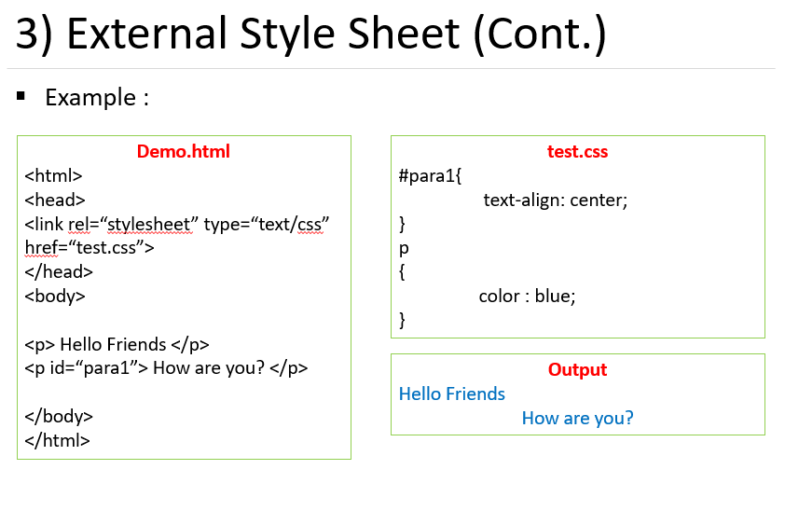

Slide 16
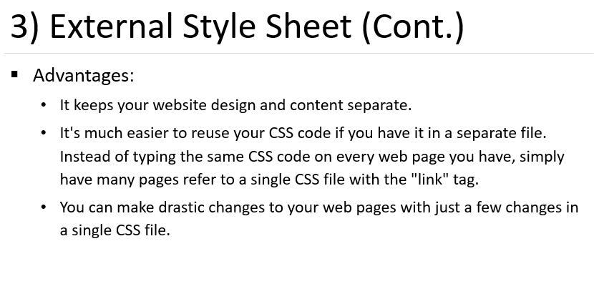

Slide 17
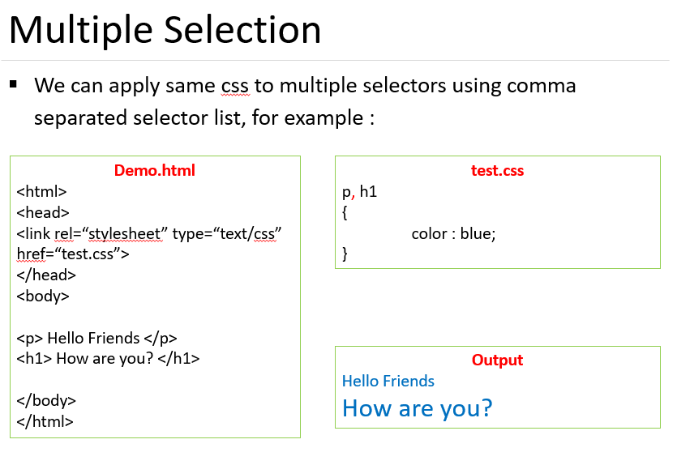

Slide 18
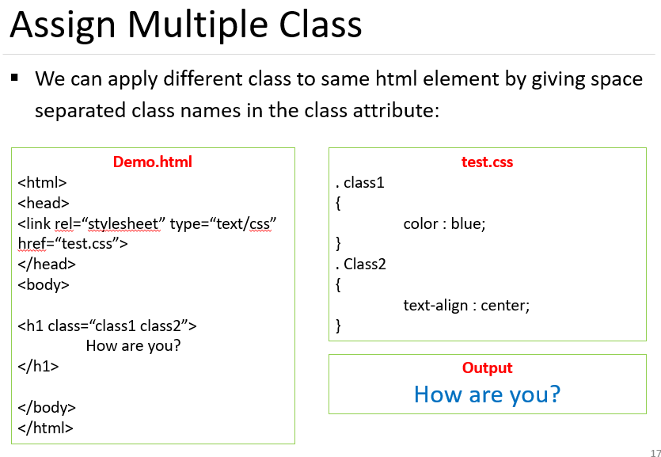

Slide 19
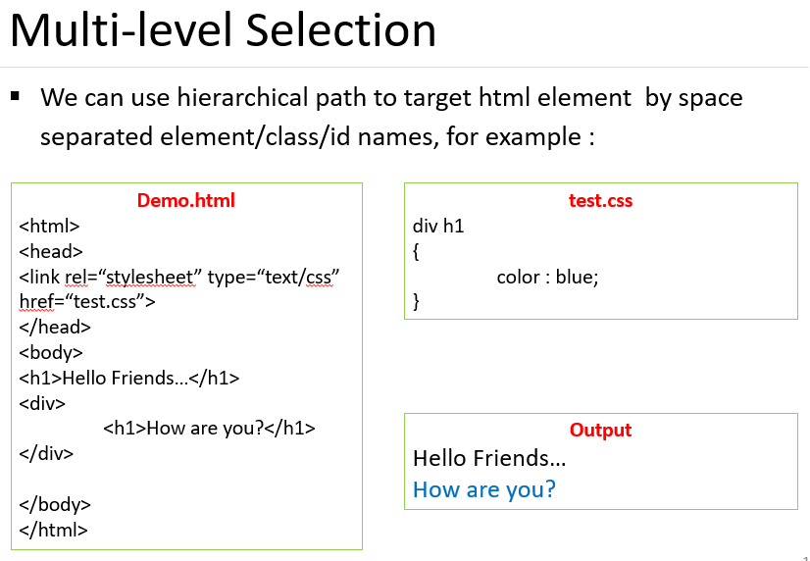

Slide 20
CSS Color
CSS colors are specified using color name, RGB, HEX, HSL, RGBA and HSLA.
Text Color
<h1 style=“text-color:red”> Hello </h1>
Border Color
<h1 style=“border-color:2px solid red”;> hello </h1>
CSS Color Values
<h1 style=“background-color: rgb(255,99,71);”> …</h1>
<h1 style=“background-color: #ff6347;”> …</h1>
<h1 style=“background-color: hsl(9, 100%, 64%);”> …</h1>

Slide 21
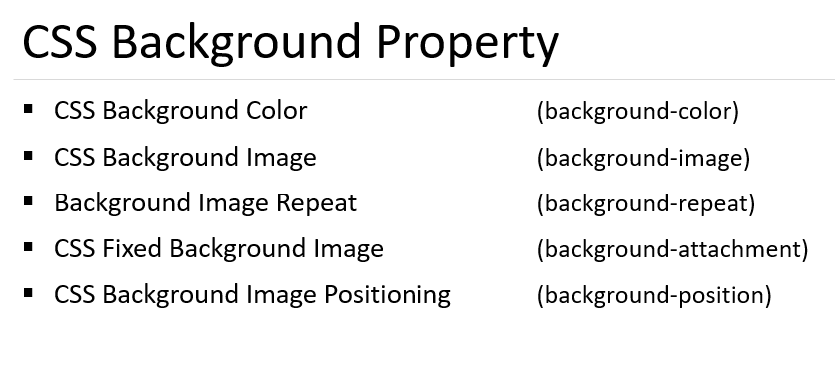

Slide 22
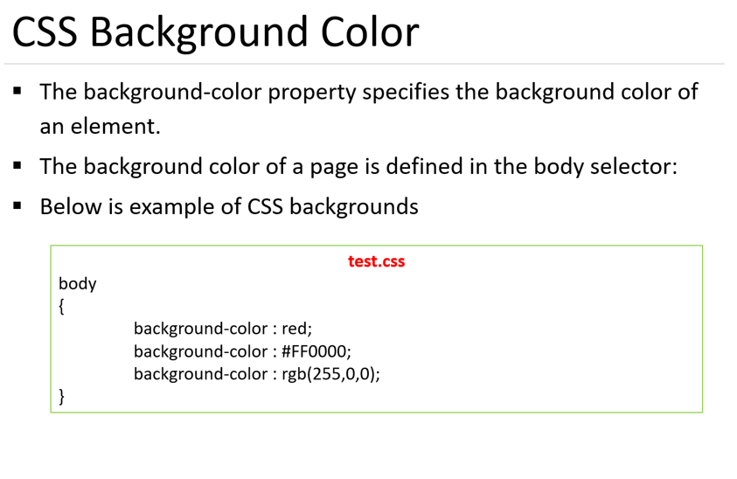

Slide 23
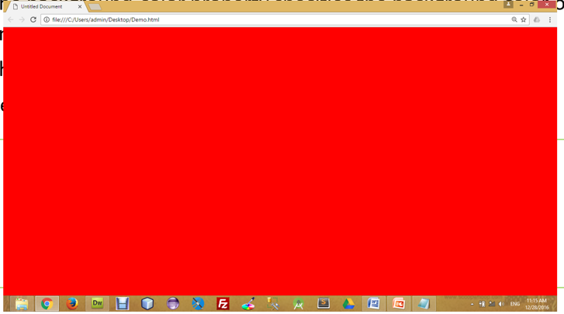

Slide 24
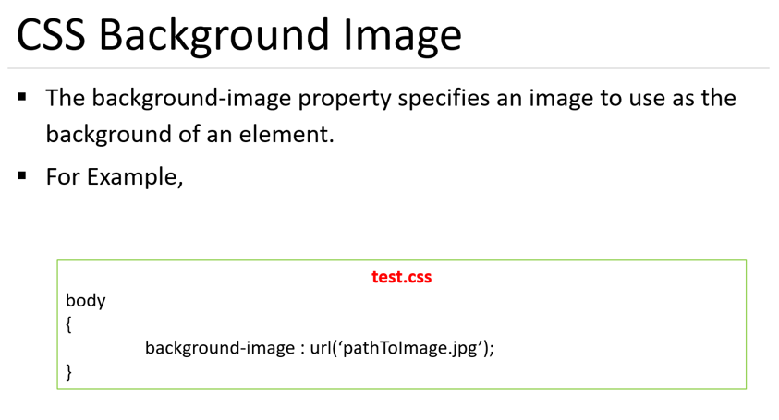

Slide 25
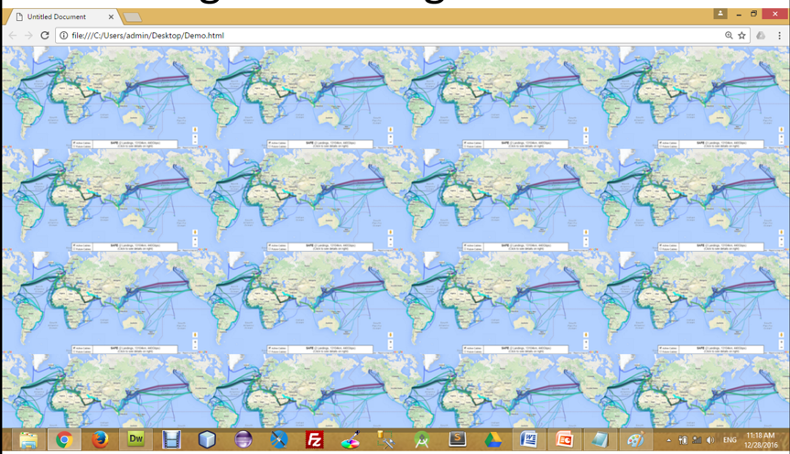

Slide 26
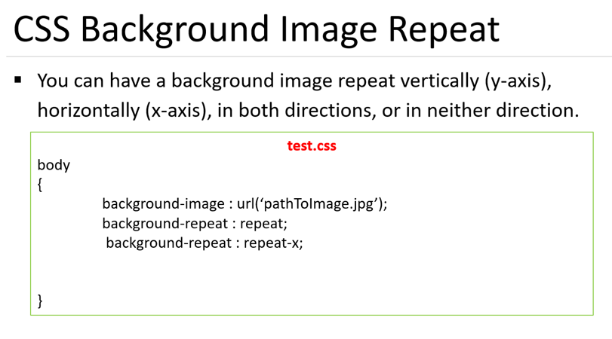
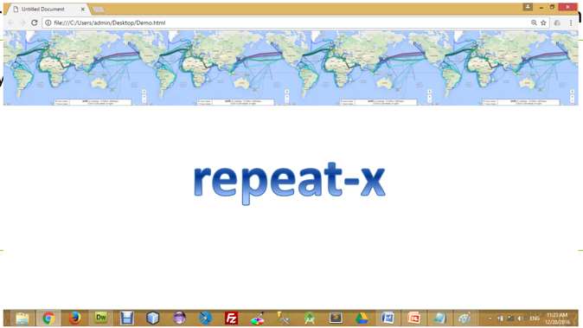

Slide 27
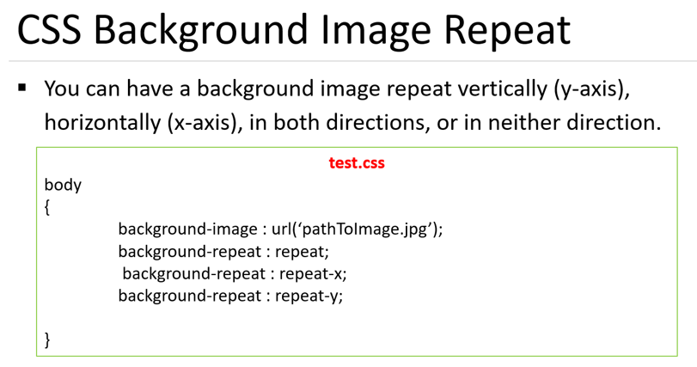
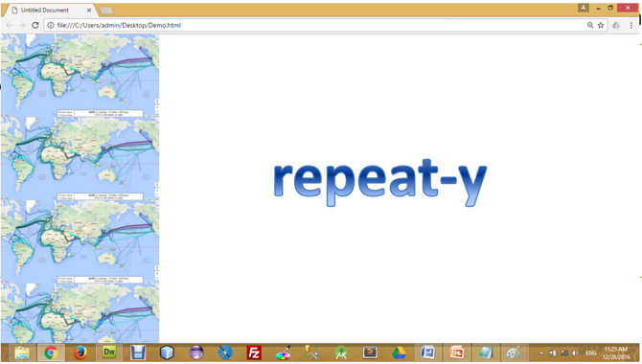

Slide 28
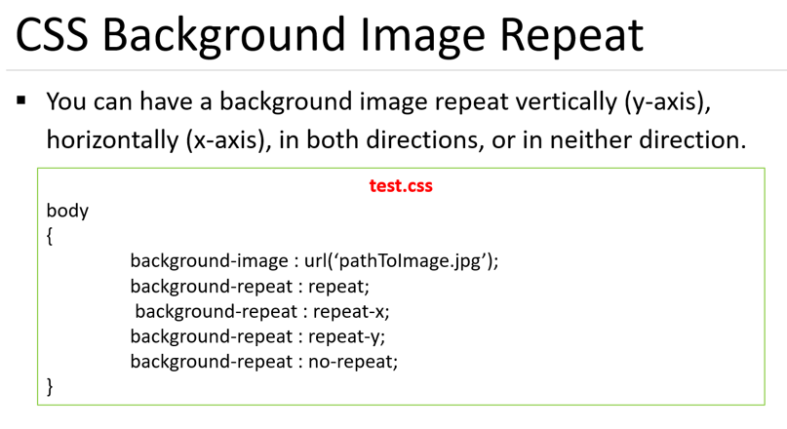


Slide 29
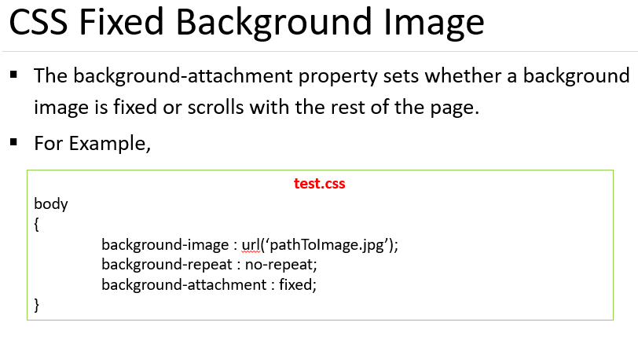

Slide 30
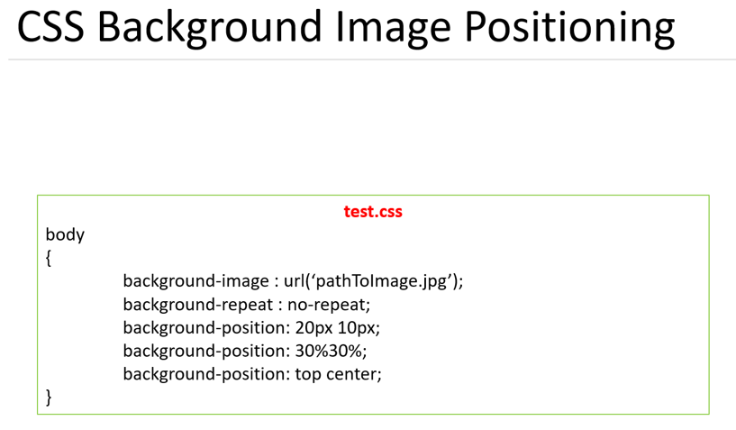
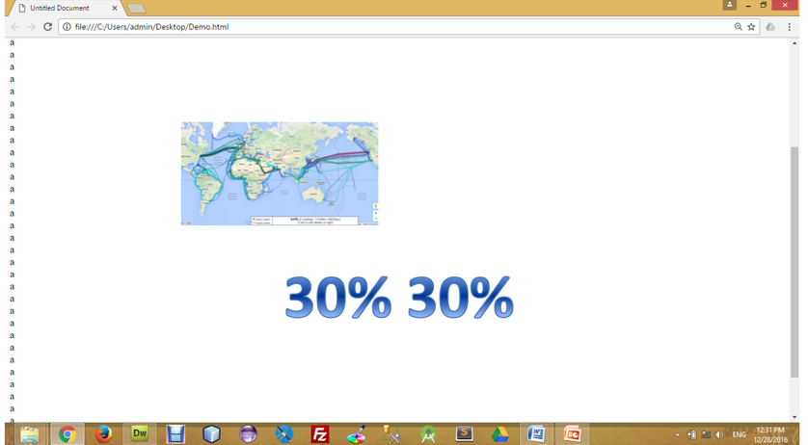

Slide 31
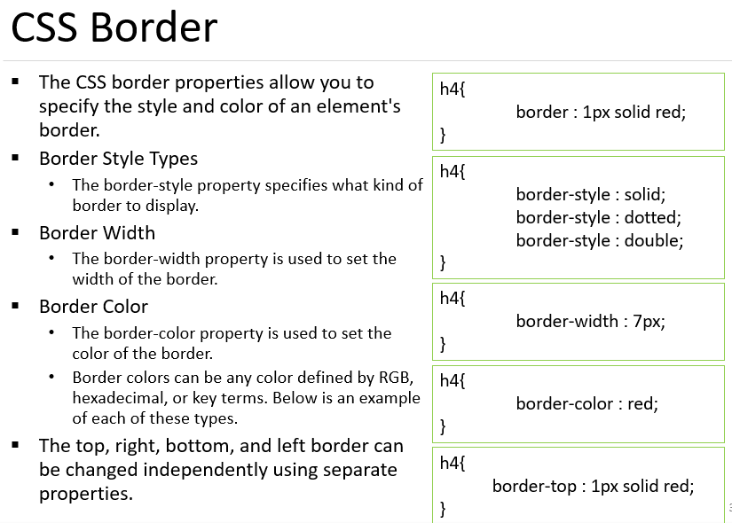

Slide 34
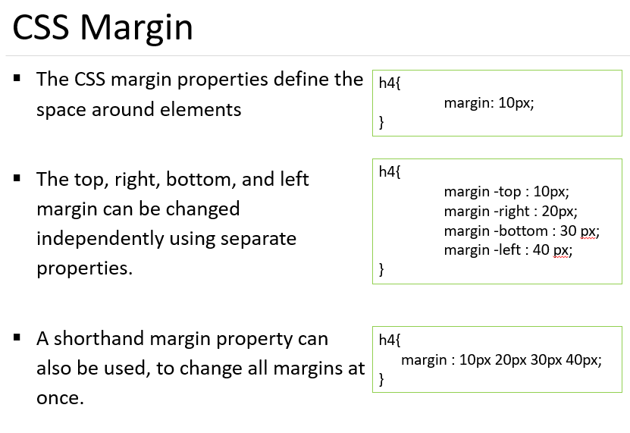

Slide 36
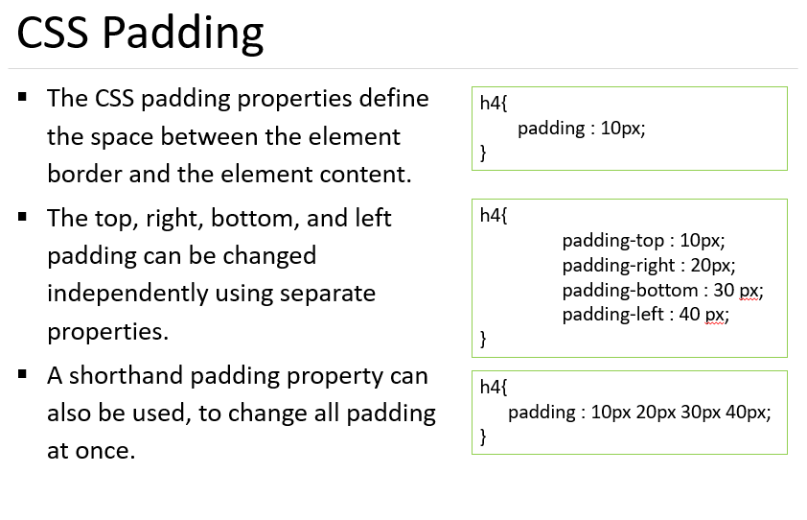

Slide 38
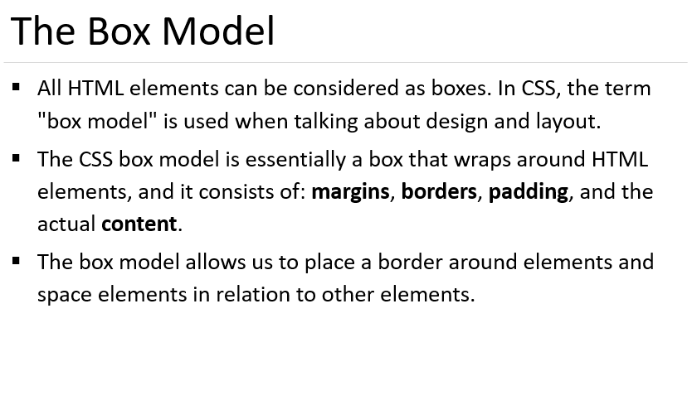
Notes:
https://www.bitdegree.org/learn/margin-css

Slide 39
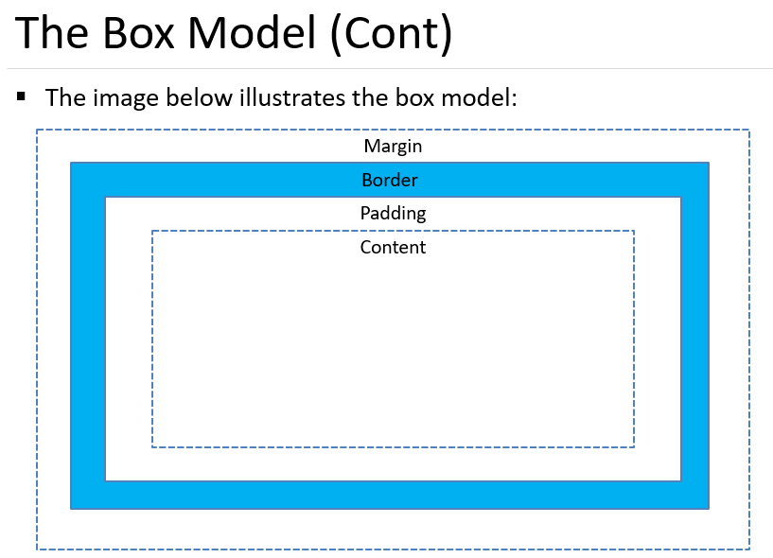

Slide 40
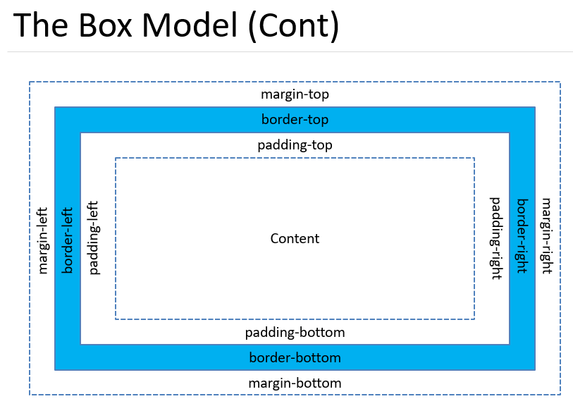

Slide 41
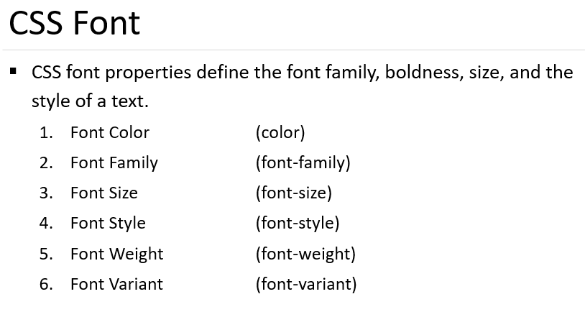
Notes:
https://www.tutorialrepublic.com/css-tutorial/css-units.php

Slide 42
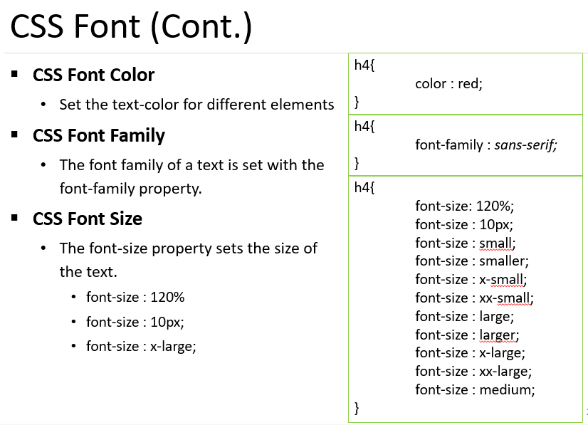
Notes:
generic font family. In CSS, a broad class of similar fonts used in a prioritized list of fonts. Common generic font families include serif (such as Times New Roman, Bodoni, and Garamond), sans-serif (such as MS Arial, MS Verdana, and Univers), and monospace (such as Courier, MS Courier New, and Prestige).
The units in which length is measured can be either absolute such as pixels, points and so on, or relative such as percentages (%) and em units.
The “em” is a scalable unit that is used in web document media.

Slide 43
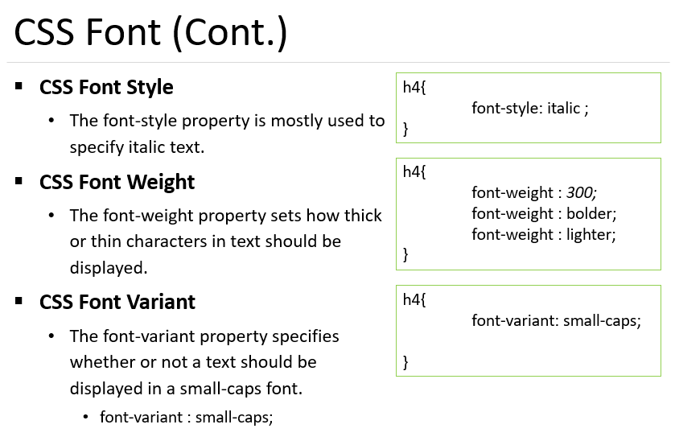
Notes:
Oblique type is a form of type that slants slightly to the right, used for the same purposes as italic type.

Slide 44
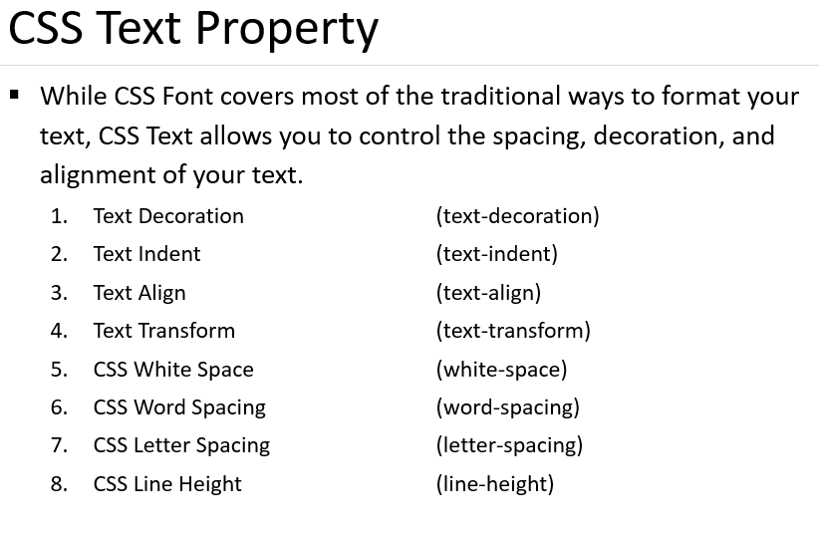
Notes:
Indent: start (a line of text) or position (a block of text) further from the margin than the main part of the text.

Slide 45
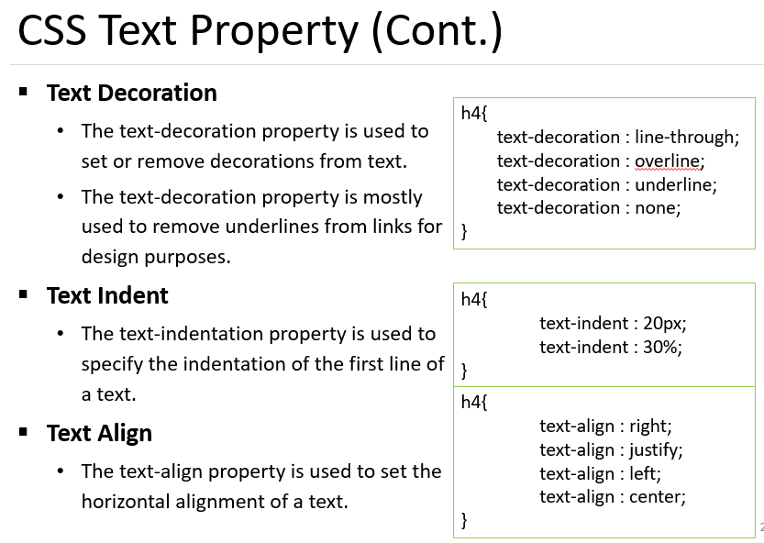

Slide 46
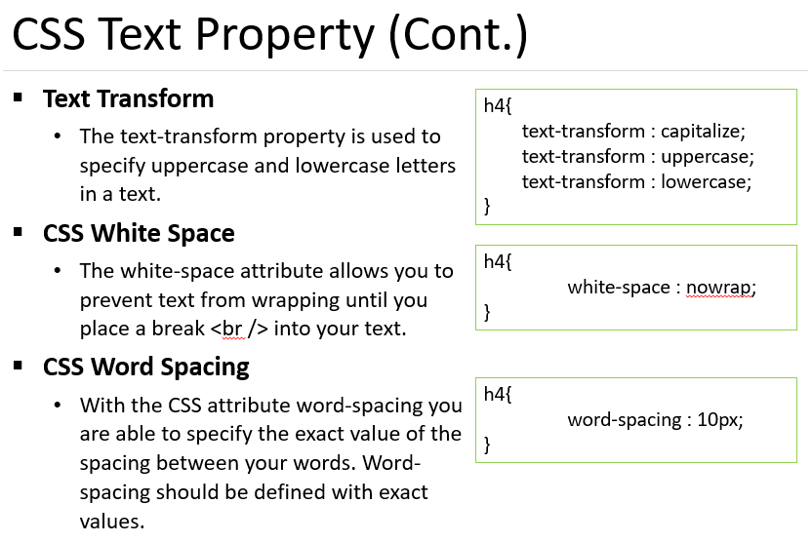

Slide 47
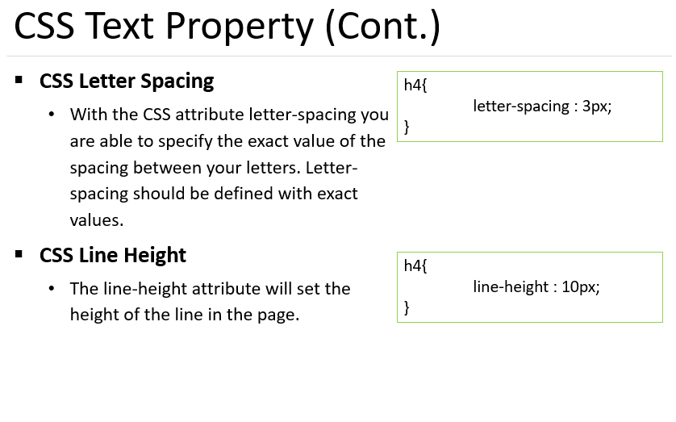

Slide 48
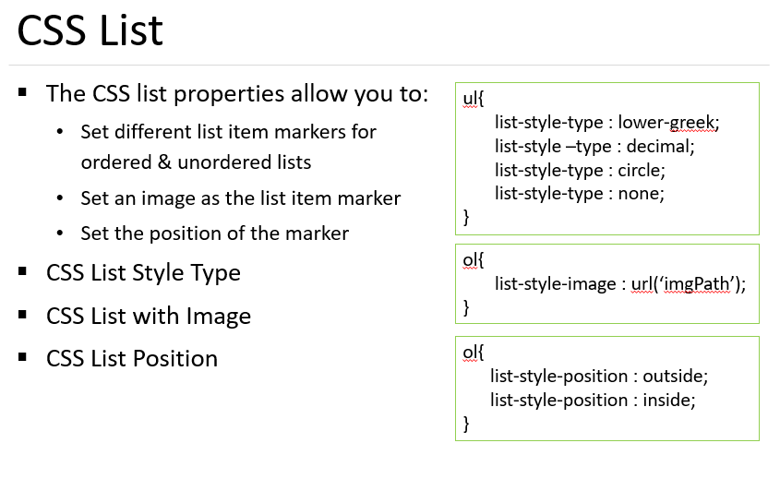

Slide 49
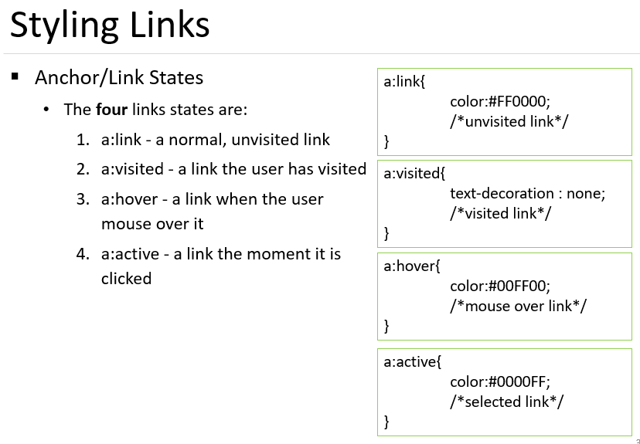

Slide 50
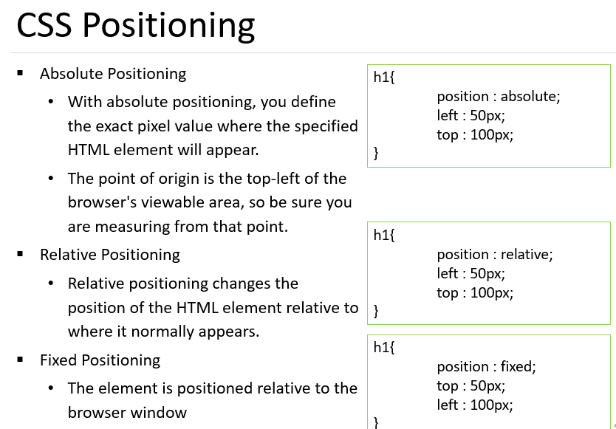

Slide 51
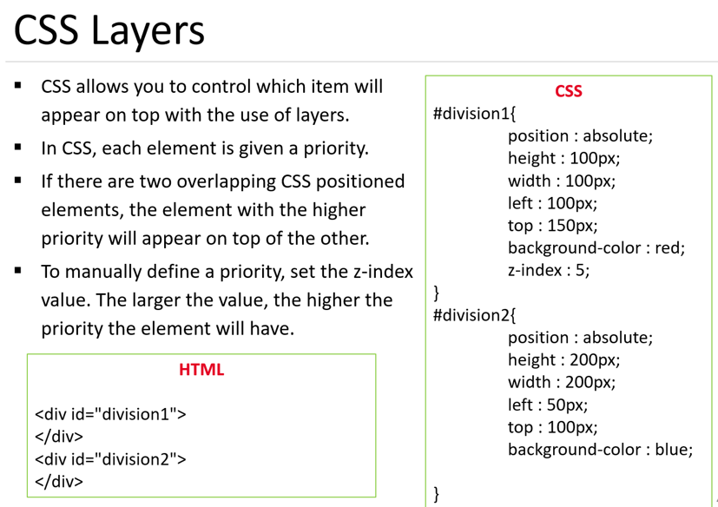

Slide 52


Slide 53
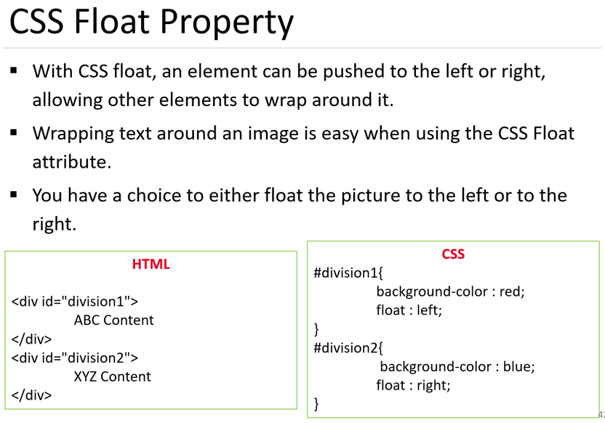

Slide 54
